Slide 1
BLM Rig Study Air Monitoring
Meeting: January 12, 2015
Data: 08/22/2014 through 12/30/ 2014

Slide 2
Study Approach
Purpose: Determine the influence of drilling operations on the actual 1-hour ambient NO₂ in the North Slope of Alaska
Question: Do drill rig operations pose a threat to any of the current ambient air quality standards?
Experimental Design:
1) Continuous emission monitors (CEMs) on the stacks of
- two 1477 bhp engines
- two 150 hp boilers
- one 2.96 MMBtu/hr heater
2) Ambient monitoring station on WSW side of DS-2N
3) Portable O₃ sampler on ENE side of DS-2N
4) Fuel Use Meters
5) Meteorological Monitoring at DS-1F

Slide 3
Drill Site 2N, Kuparuk River Unit, North Slope Alaska
Nabors 9ES Drill Rig and Ambient Monitoring Station

Slide 4
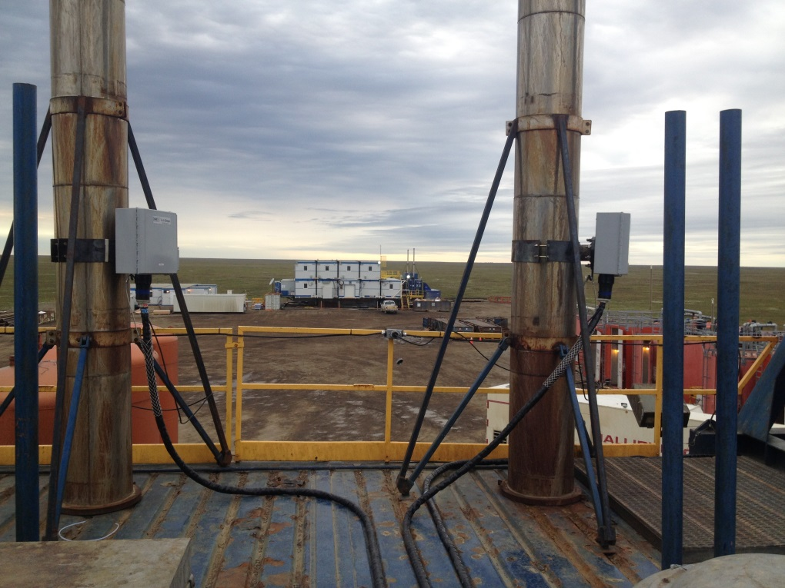
Drill Site 2N, Kuparuk River Unit, North Slope Alaska
CEMS on Nabors 9ES Drill Rig

Slide 5
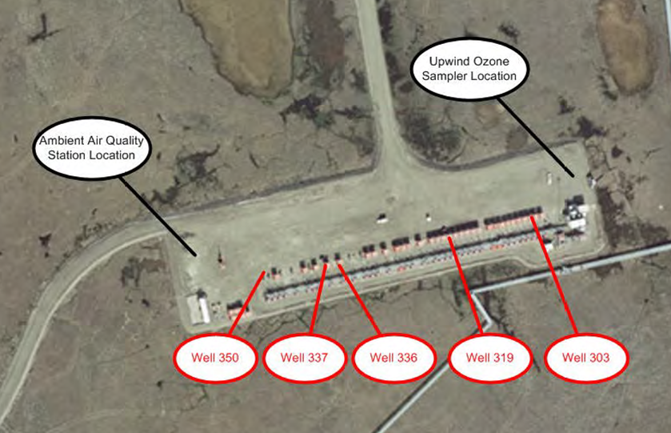
Rig Generator Use & Rig Movement
Rig Generator Use: | Engine 1 | Engine 2
Well 2N-303 | 9/7/2014 11:00 - 9/14/2014 9:00 | Engine Offline
Well 2N-350 | 10/23/2014 9:00 - 10/24/2014 15:00 | 10/24/2014 8:00 - 10/24/2014 15:00
Well 2N-319 | 10/24/2014 15:00- 11/10/2014 17:00 | 10/24/2014 15:00 11/10/2014 17:00
Well 2N-337 | 11/28/2014 12:00- 12/29/2014 13:00 | 12/7/2014 12:00- 12/26/2014 9:00
Portable O₃
Station Location
Well Name | Rig Accept | Rig Release
2N-303 | 8/20/2014 23:59 | 9/15/2014 23:59
2N-350 | 9/16/2014 00:00 | 10/24/2014 15:00
2N-319 | 10/24/2014 15:00 | 11/27/2014 00:00
2N-337 | 11/28/2014 12:00 | 12/27/2014 12:00
2N-336 | 12/28/2014 06:00 | N/A, Study ended 12/31/2014

Slide 6
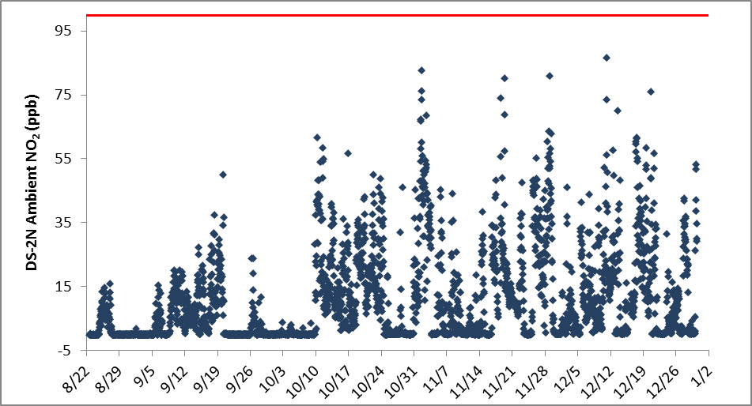
Ambient NO₂
Wind direction from ENE/E/NE
Off grid 9/7-9/14
Off grid 10/23-11/10
Off grid 11/28- 12/29
Well 2N-303
Well 2N-350
Well 2N-319
Well 2N-337
Well 2N-336
Well 2N-303
Well 2N-350
Well 2N-319
Well 2N-337
Well 2N-336
Pic.
Pic.
Pic.
Pic.
11/18 15:00
11/2 18:00
12/13 15:00
No Pic.
Pic.
Pic.
Pic.
10/11

Slide 7
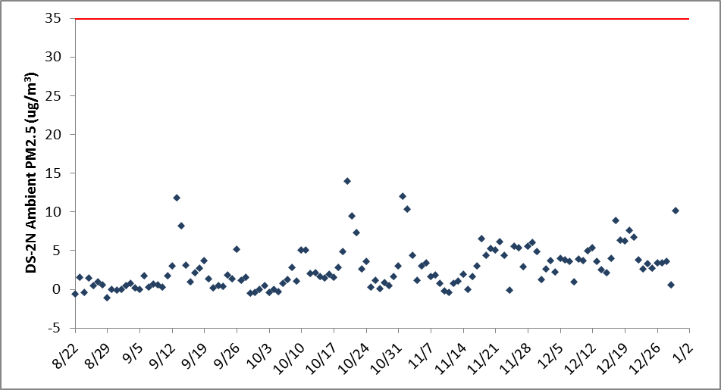
Ambient Particulate Matter_{2.5}
Off grid 9/7-9/14
Off grid 10/23-11/10
Off grid 11/28- 12/29
Well 2N-303
Well 2N-350
Well 2N-319
Well 2N-337
Well 2N-336
Wind direction from ENE/E

Slide 8
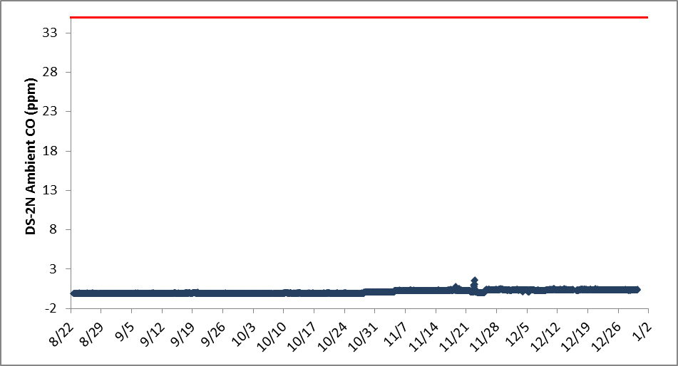
Ambient CO
Off grid 9/7-9/14
Off grid 10/23-11/10
Off grid 11/28- 12/29
Well 2N-303
Well 2N-350
Well 2N-319
Well 2N-337
Well 2N-336

Slide 9
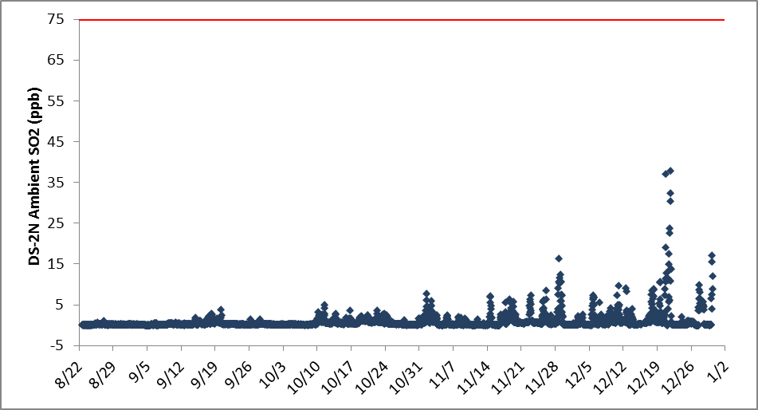
Ambient SO₂
Off grid 9/7-9/14
Off grid 10/23-11/10
Off grid 11/28- 12/29
Well 2N-303
Well 2N-350
Well 2N-319
Well 2N-337
Well 2N-336
Wind direction from ENE/E

Slide 10
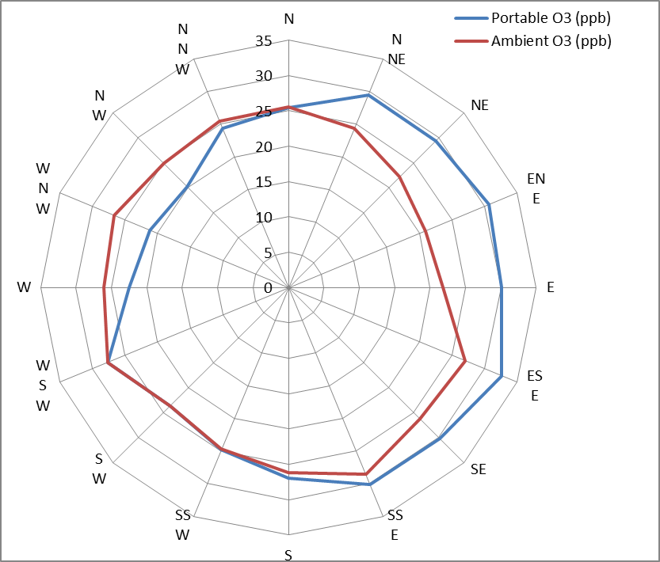
Upwind/Downwind Ozone
Portable O₃
Station Location

Slide 11
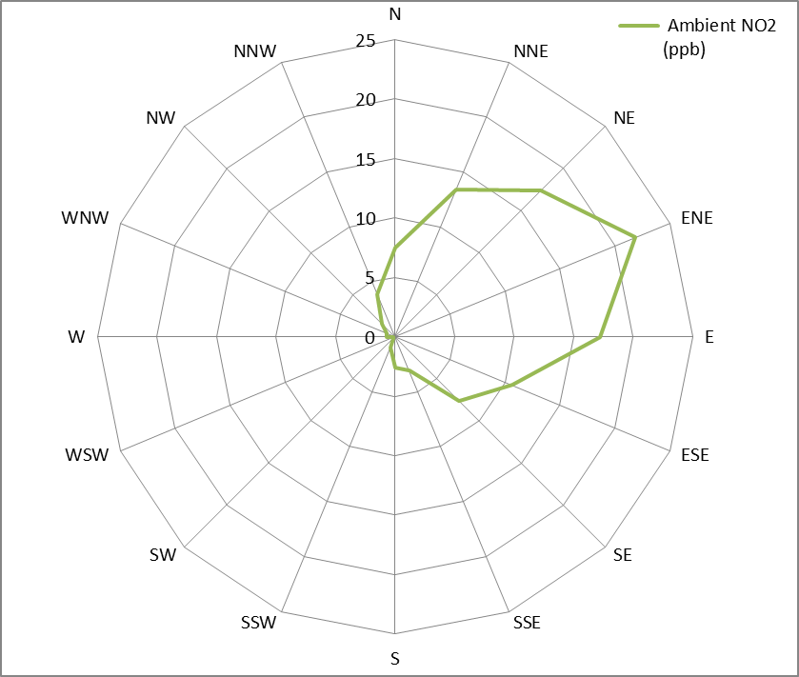
Ambient NO₂ and Wind Direction
Portable O₃
Station Location

Slide 12
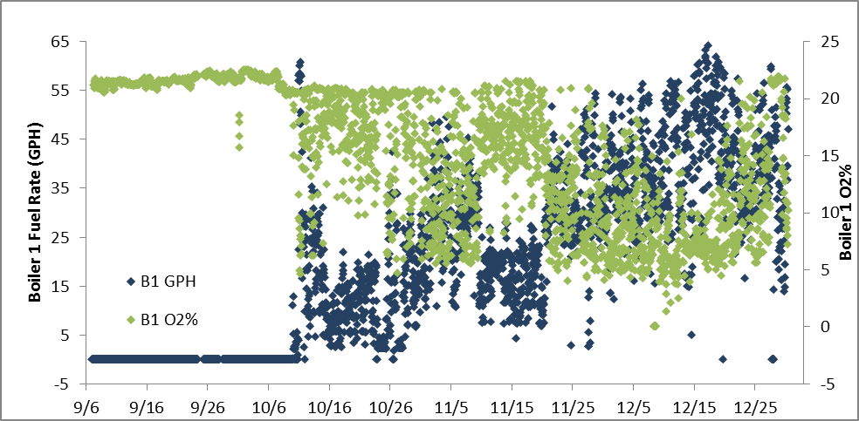
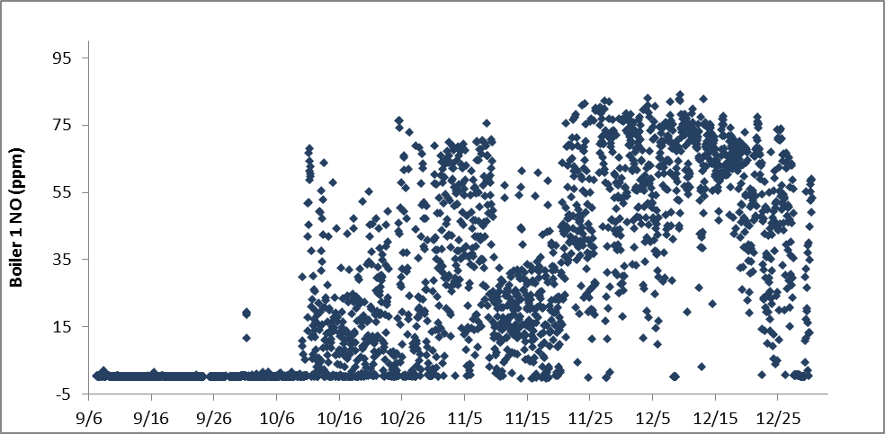
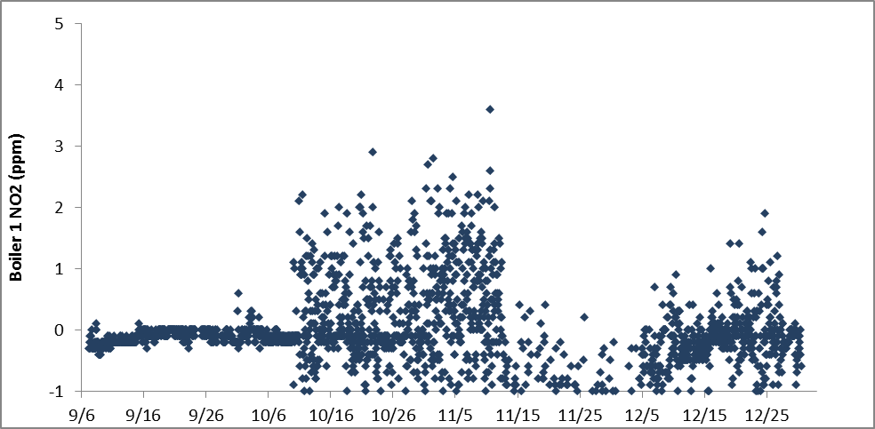
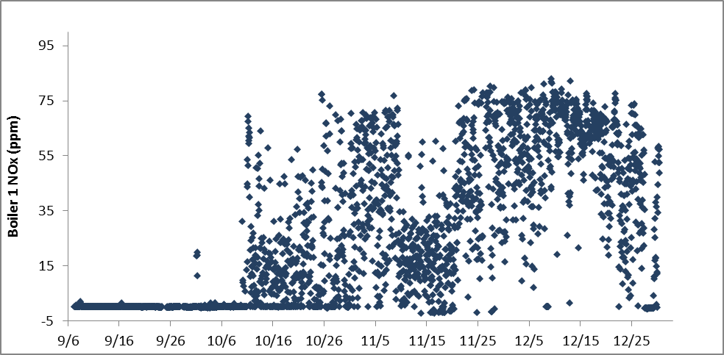
Boiler 1: Fuel Rate, O₂ %, NO_{x}, NO, NO₂
303
350
319
337
336
303
350
319
337
336
303
350
319
337
336
303
350
319
337
336
*Note: Boiler fuel use inherently fluctuates more than heaters and engines

Slide 13
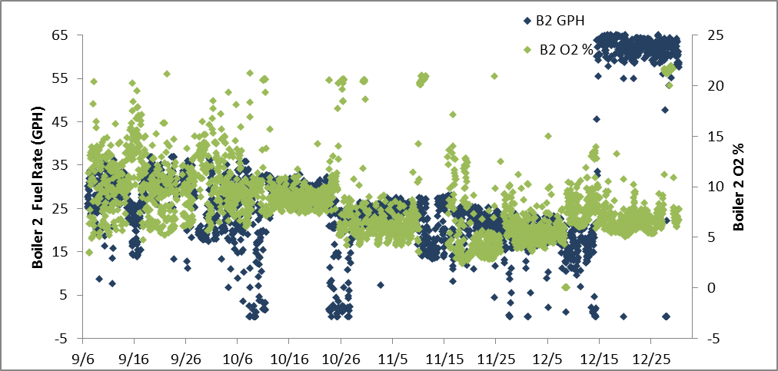
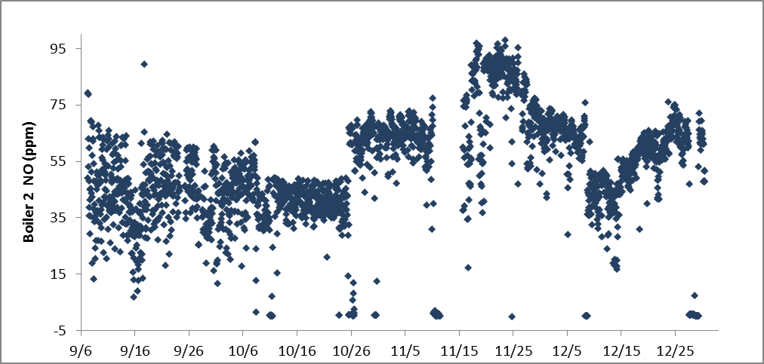
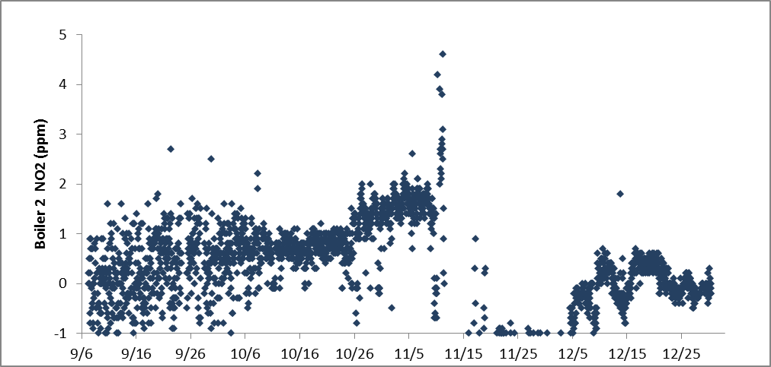
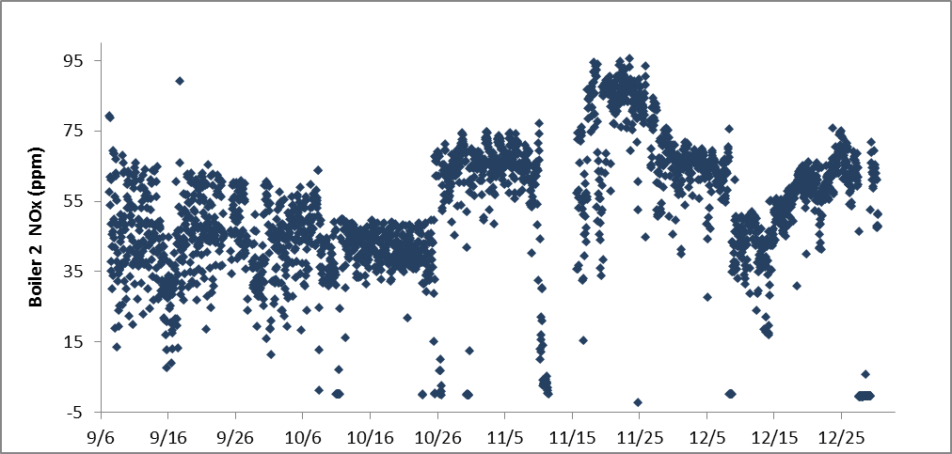
Boiler 2: Fuel Rate, O₂ %, NO_{x}, NO, NO₂
303
350
319
337
336
303
350
319
337
336
303
350
319
337
336
303
350
319
337
336
*Note: Boiler fuel use inherently fluctuates more than heaters and engines

Slide 14
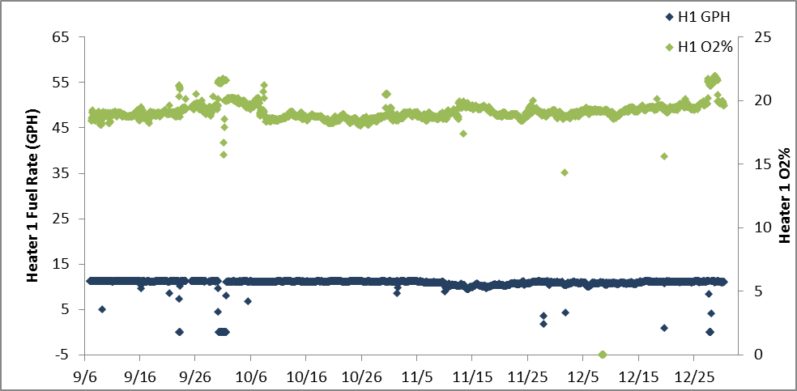
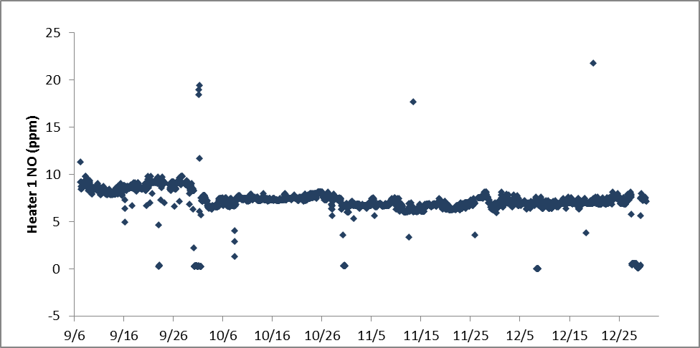
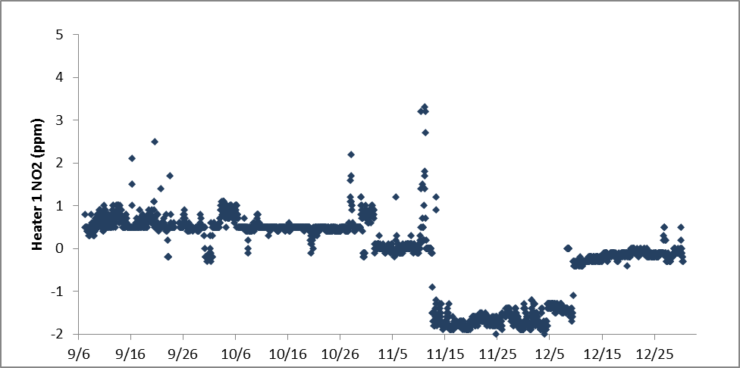
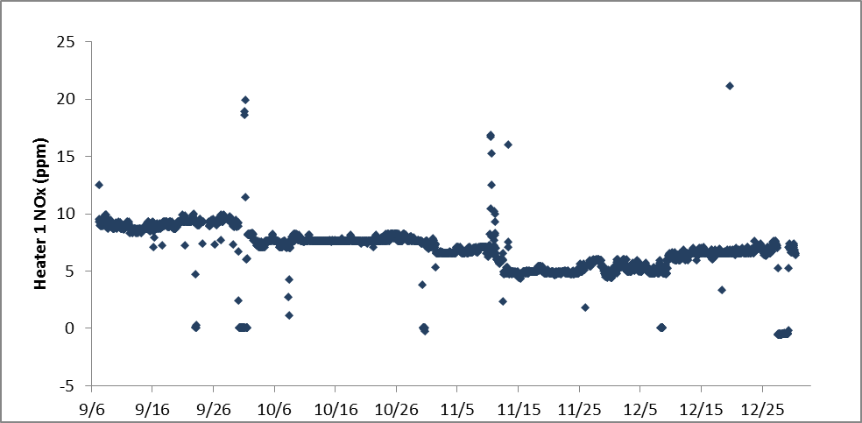
Heater 1: Fuel Rate, O₂ %, NO_{x}, NO, NO₂
303
350
319
337
336
303
350
319
337
336
303
350
319
337
336
303
350
319
337
336

Slide 15
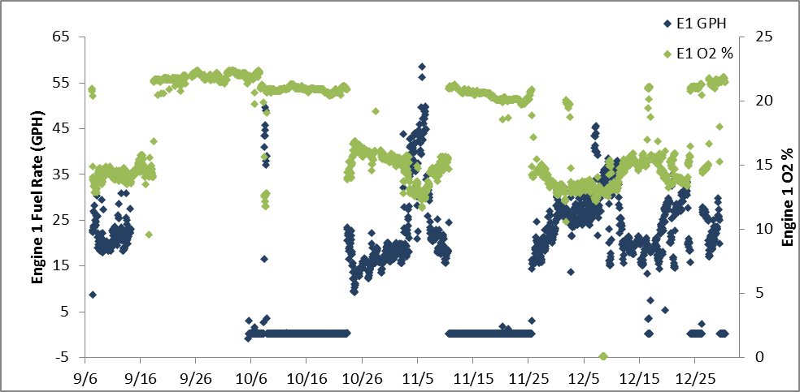
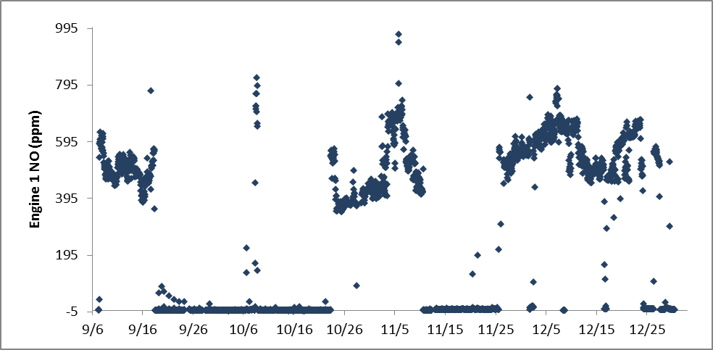
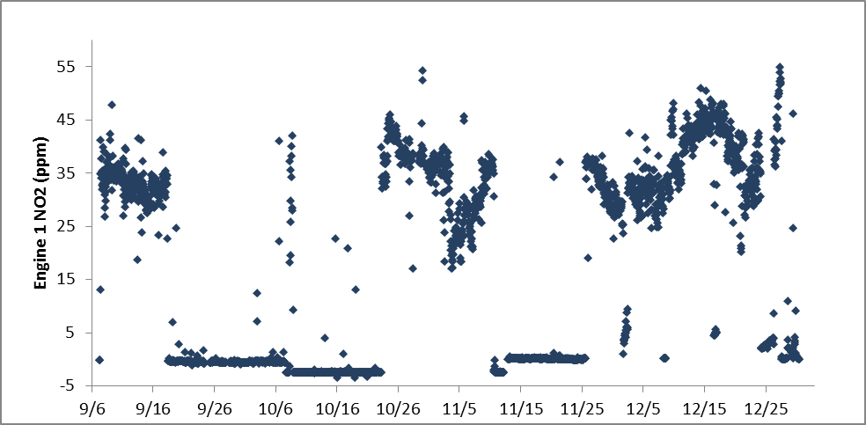
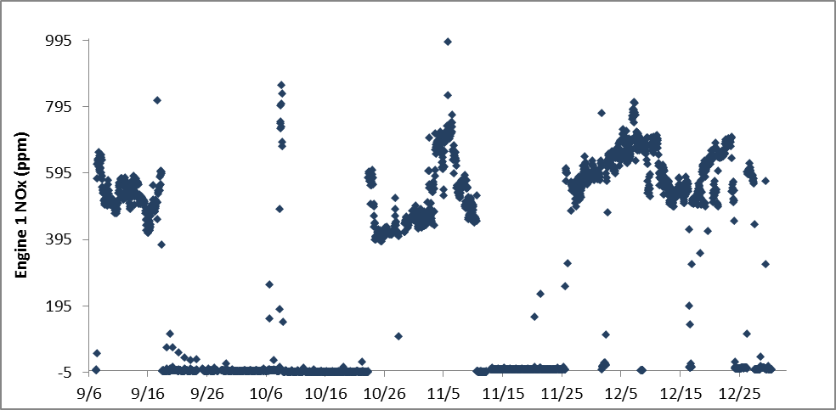
Engine 1: Fuel Rate, O₂ %, NO_{x}, NO, NO₂
303
350
319
337
336
303
350
319
337
336
Engine offline
303
350
319
337
336
303
350
319
337
336

Slide 16
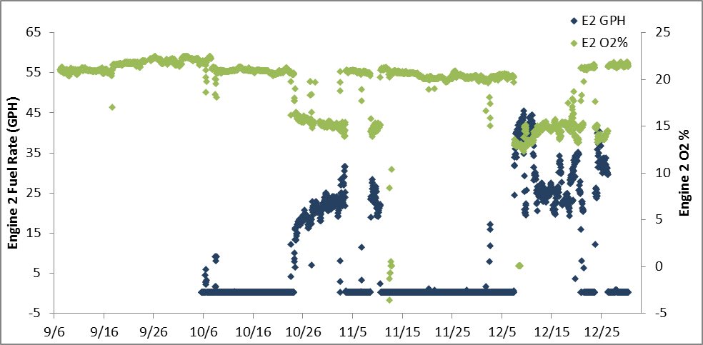
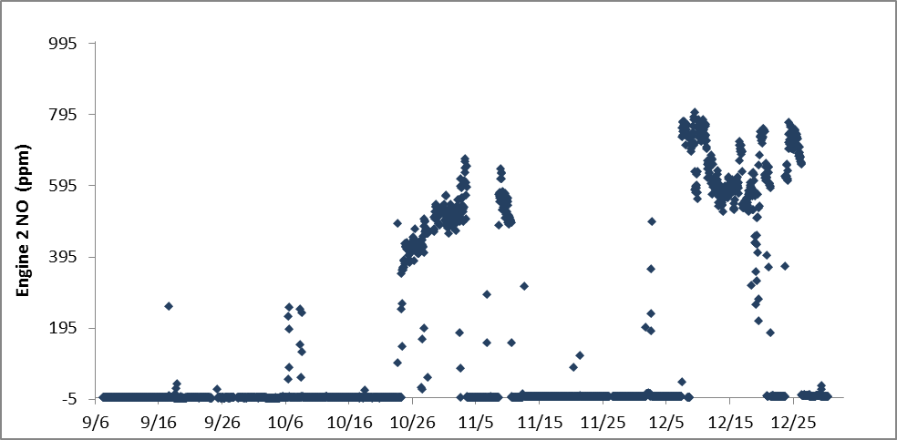
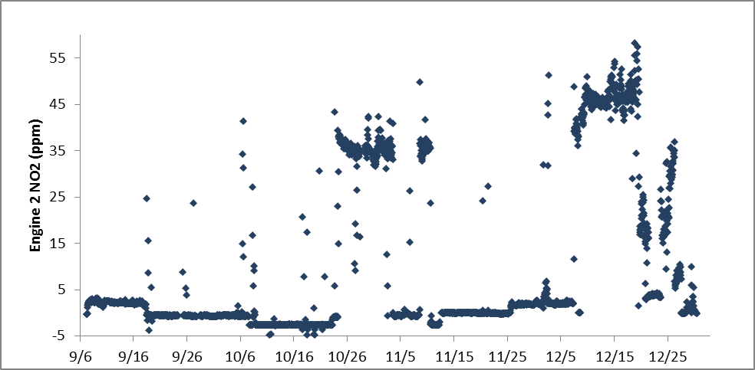
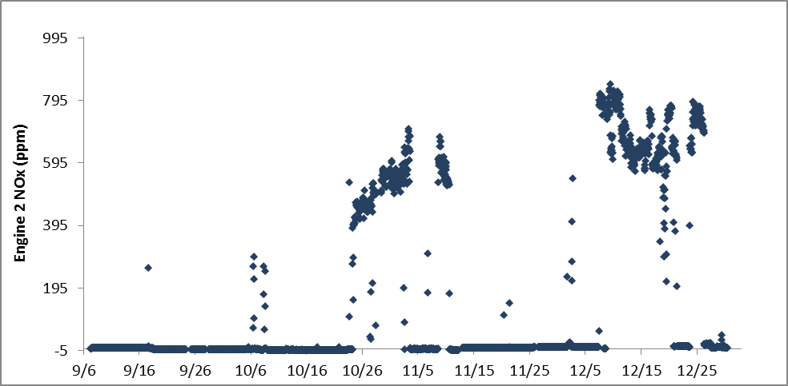
Engine 2: Fuel Rate, O₂ %, NO_{x}, NO, NO₂
303
350
319
337
336
303
350
319
337
336
Engine offline
303
350
319
337
336
303
350
319
337
336

Slide 17
Next Steps
End date of the study:
Data collection ended on 12/31 after rig on well 336 for 3 days
SLR calibrate Monitoring Stations/CEMS and Finalize the Data with QA/QC checks:
SLR visiting DS-2N on January 6th to remove CEMS, and collect ozone analyzer data with ambient station ozone.
SLR will compile all of the data into a large file for us after final QA/QC of data
Distribution complete by the end of January
Demobilization of the Monitoring Equipment:
Ambient Station, Ozone Sampler, Fuel Meters, CEMS, and Met Station

